Slide 1
Download These Slides
http://people.csail.mit.edu/seneff/
2018/Toronto.pptx

Slide 2
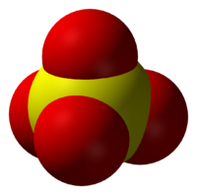
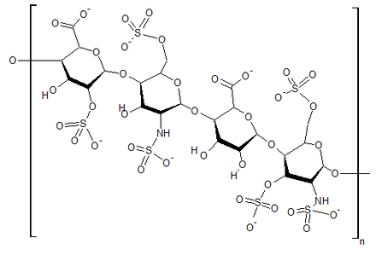

Sulfate is the most common nutritional deficiency that you never heard of
Stephanie Seneff
MIT CSAIL

Slide 3
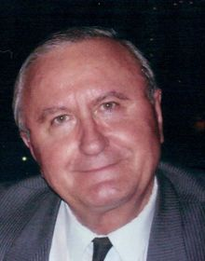
In Memory Of John Balatinecz
January 19, 1937 – August 6, 2017

Slide 4






Shiv Chopra
Some John Balatinecz “Groupies”
Rachel Parent
Tony Mitra
Zen Honeycutt
Jack Wilson
Notes:
Shiv Chopra died January 7th 2018.
Images/ShivChopra.jpg

Slide 5
John Balatinecz Email message to Jack Wilson:
“Since you are a super DIN (i.e. do it now) person, and are even educating doctors one at a time, why don’t you contact David Mathews, the attorney in Texas, who is building a case against Monsanto (dmlawfirm.com). He might even post your latest pamphlet in his website ... Your info might even speed up his decision to start the lawsuit of the century.”
Praise
Guidance
Optimism

Slide 6
Outline
Introduction
Cholesterol Sulfate
Glycocalyx & Heparan Sulfate
Bile Acids
Glyphosate
Diseases Linked to Sulfate Deficiency
Curcumin and Other Flavonoids
Prevention of Disease through Diet and Lifestyle

Slide 7
The Big Ideas
Cardiovascular disease is a cholesterol sulfate deficiency problem
Heparan sulfate deficiency is a key factor in autism
Most modern diseases that are on the rise are mechanisms to renew sulfate supply to the blood
Glyphosate (the active ingredient in the pervasive herbicide Roundup) disrupts the body’s ability to properly synthesize and utilize sulfate
Taurine is a storage form of sulfate

Slide 8
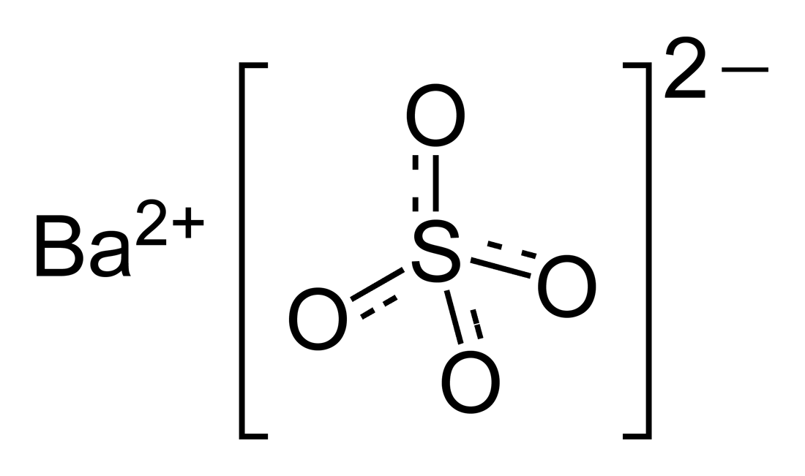
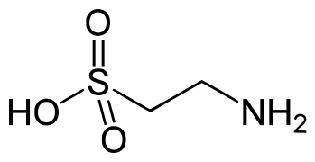
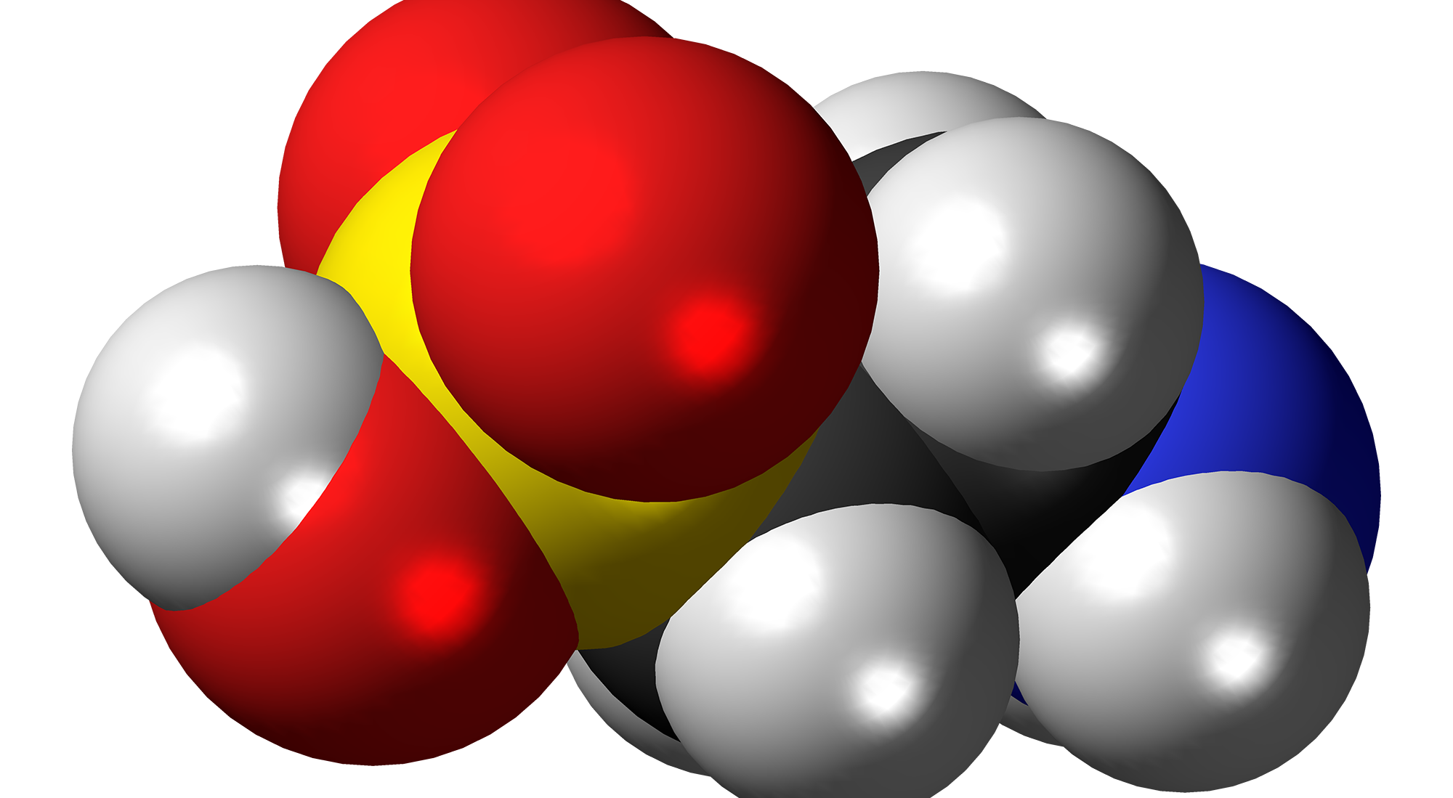
Taurine: Brief Chemistry Refresher Course
Taurine is the only sulfonated amino acid
  It does not incorporate into proteins
  It is the most common free amino acid in the body
  It is stored in large quantities in the heart , brain and liver
Human cells can not metabolize taurine, but microbes can extract its sulfur atom to synthesize sulfate or methionine for the host
Sulfate = SO₄⁻² =
=
Taurine = C₂H₇NO₃S =
=

Slide 9
Perinatal Taurine is Essential*
Taurine accumulates in maternal tissues during pregnancy, and is released to the fetus during the perinatal period
Mother's milk is rich in taurine, and it accumulates in the neonatal brain
Taurine deficiency in the mom leads to:
  Growth retardation in the offspring (insufficient methionine?)
  Impaired development of central nervous system and pancreas
  Impaired glucose tolerance and vascular dysfunction
Gestational diabetes in offspring transmits the effects to the next generation
*L Aerts and FA Van Assche. J Perinat Med. 2002;30(4):281-6.
Notes:
Taurine_perinatal.text

Slide 10
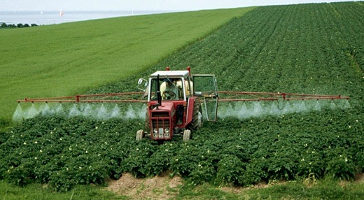

Roundup and GMO Crops
GMO Roundup-Ready corn, soy, canola, sugar beets
cotton, tobacco and alfalfa
What is glyphosate?

Slide 11
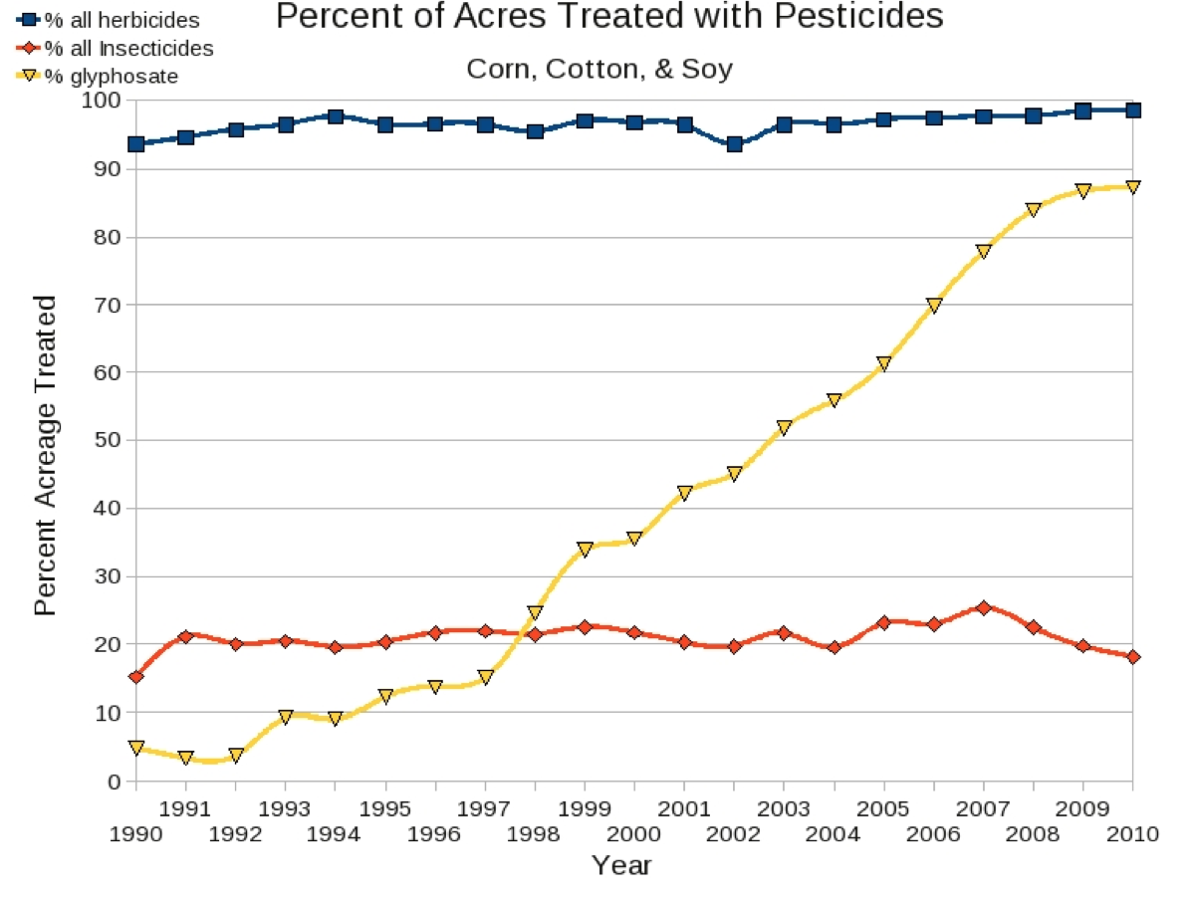
Glyphosate vs. Other Pesticides: Usage in the United States*
Glyphosate
*http://sustainablepulse.com/wp-content/uploads/GMO-health.pdf

Slide 12
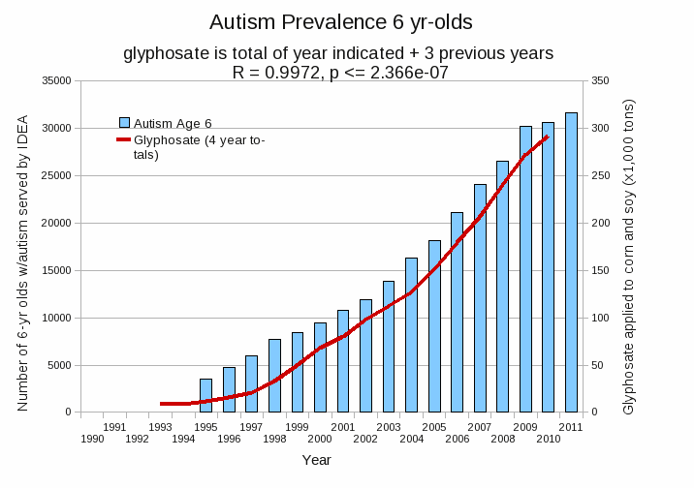
Autism Prevalence: 6 year olds*
R = 0.9972
* Figure 15, Seneff et al., Agricultural Sciences, 2015, 6, 42-70
Notes:
Nancy/latest_plots/6-yr-old autism.gif
autism: USDE
oil consumption: USDA
glyphosate: USDA
GE crops: USDA
Mortality data: CDC

Slide 13
Cholesterol Sulfate

Slide 14

They Knew a Long Time Ago*
Article published in 1960
Fed cholesterol to monkeys
  induced atherosclerosis
If sulfur-containing nutrients are added, atherosclerosis is prevented
These nutrients provide source of sulfate to enable cholesterol transport
* G.V. Mann et al., Am. J. Clin. Nutr. 8, 491-497, 1960.
Notes:
./ monkeys_sulfur_solves_cholesterol_problem_1960

Slide 15
They Knew a Long Time Ago*
Article published in 1960
Fed cholesterol to monkeys
  induced atherosclerosis
If sulfur-containing nutrients are added, atherosclerosis is prevented
These nutrients provide source of sulfate to enable cholesterol transport
"A form of vascular disease resembling human atherosclerosis has been produced in the New World primate Cebus fatuella. ... In order to produce these phenomena, the diets had to be rich in cholesterol, choline and neutral fat but relatively low in organic sulfur compounds. Without this deprivation of organic sulfur the response of the serum lipids to cholesterol feeding was small."
* G.V. Mann et al., Am. J. Clin. Nutr. 8, 491-497, 1960.
Notes:
./ monkeys_sulfur_solves_cholesterol_problem_1960

Slide 16
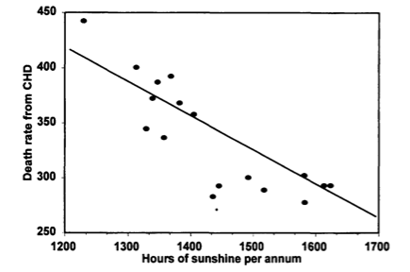
Heart Disease Mortality and Sunlight*
*Grimes et al., Q. J. Med. 1996; 89:579-589
Notes:
vitaminK/sunlight_heart_disease.pdf

Slide 17

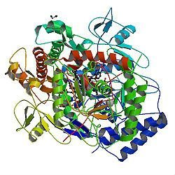
A Provocative Proposal*
Cholesterol sulfate supplies oxygen, sulfur, cholesterol, energy and negative charge to all the tissues
  Also protects skin from UV damage and keeps microbes out
Sulfate is synthesized from sulfide in the skin and blood stream utilizing energy in sunlight
Endothelial Nitric Oxide Synthase (eNOS) performs the magic
The skin is a solar powered battery!
*S Seneff et al., Entropy 2012, 14, 2492-2530.

Slide 18
A Provocative Proposal*
Cholesterol sulfate supplies oxygen, sulfur, cholesterol, energy and negative charge to all the tissues
  Also protects skin from UV damage and keeps microbes out
Sulfate is synthesized from sulfide in the skin and blood stream utilizing energy in sunlight
Endothelial Nitric Oxide Synthase (eNOS) performs the magic
Melanin converts UV light to visible light, and the flavins in eNOS respond to blue light by emitting electrons
The skin is a solar powered battery!
*S Seneff et al., Entropy 2012, 14, 2492-2530.

Slide 19
A Provocative Proposal*
Cholesterol sulfate supplies oxygen, sulfur, cholesterol, energy and negative charge to all the tissues
  Also protects skin from UV damage and keeps microbes out
Sulfate is synthesized from sulfide in the skin and blood stream utilizing energy in sunlight
Endothelial Nitric Oxide Synthase (eNOS) performs the magic
These electrons produce superoxide from oxygen that combines with sulfur to form sulfate
The skin is a solar powered battery!
*S Seneff et al., Entropy 2012, 14, 2492-2530.

Slide 20
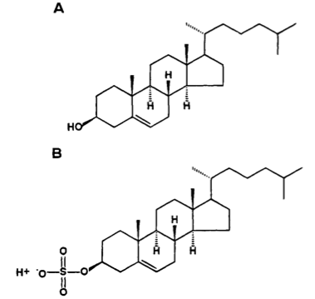
Cholesterol and Cholesterol Sulfate
Sulfation makes cholesterol water-soluble and therefore much easier to transport
SULFATE
Notes:
From cholesterol_sulfate_agile.pdf – this was the original article on that topic.

Slide 21
Cholesterol sulfate provides negative charge*
-
-
-
-
-
-
-
-
-
-
-
-
-
-
-
-
-
-
-
-
-
-
-
-
-
-
-
-
-
-
-
-
-
-
-
-
-
-
-
-
-
-
-
-
-
-
-
-
-
-
-
-
-
-
-
-
-
Red blood cells export cholesterol sulfate to the capillary wall, supplying it with cholesterol, sulfate, and negative charge
* Davidson and Seneff, Entropy 14, 1399-1442, 2012.

Slide 22
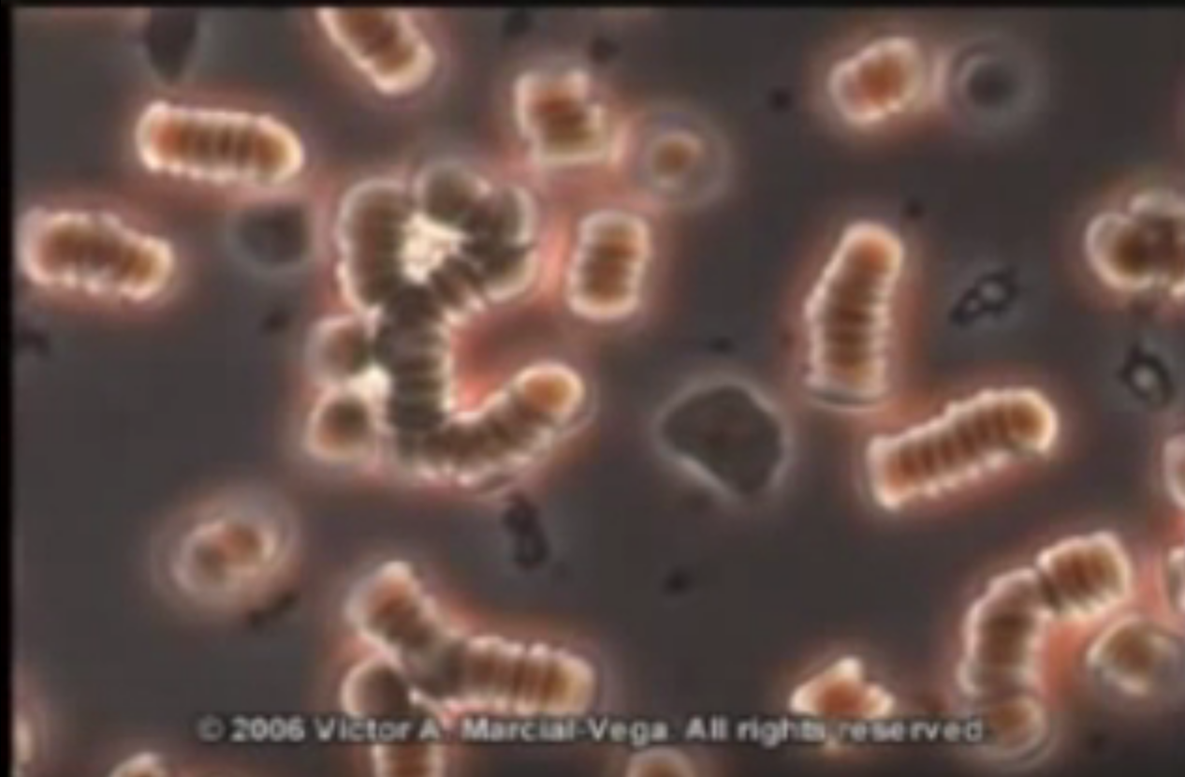
Rouleaux –
Insufficient Negative Charge*
*Dr. Marcial Vega; https://www.youtube.com/watch?v=9vhHe55s9rg

Slide 23
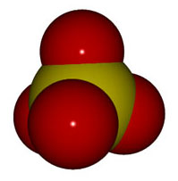
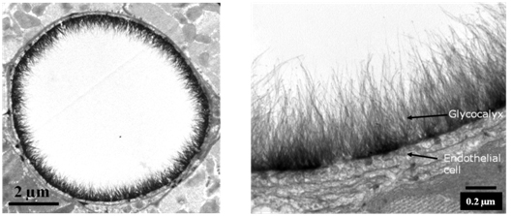
Sulfate and the Glycocalyx
Expanded View
Artery
Cross Section

Slide 24
Sulfate is Crucial to Maintain Structured Water in the Glycocalyx

Slide 25
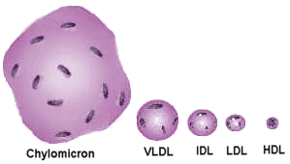
Lipid Particles in blood depend on cholesterol sulfate to protect them from oxidative and glycation damage

Slide 26
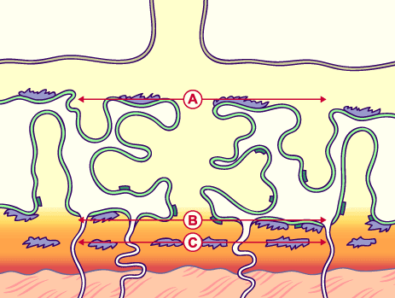
Cholesterol Sulfate in Placental Villi*
Placental villi are highly enriched in cholesterol sulfate, especially in third trimester of pregnancy
Mother’s serum cholesterol sulfate steadily rises through pregnancy
In third trimester, villi contain 24 picomol/mg of cholesterol sulfate, compared to only 1.5 in blood serum of a non-pregnant woman
* Lin et al., Journal of Chromatography B, 704 (1997) 99–104
Notes:
./Lin.cholesterol\ sulfate.pregnancy.pdf

Slide 27
Sulfate in Fetal Development*
Fetus depends on mother for sulfate supply
Sulfate is essential for transporting sterols (like estrogen and DHEA) and supplying extracellular matrix proteins everywhere with sufficient negative charge
Sulfate detoxifies xenobiotics like acetaminophen (Tylenol) and is essential for excreting toxins like aluminum and mercury
Sulfate is severely deficient in autistic children (1/3 the normal level of free sulfate in blood stream)
* Dawson, “Sulfate in Fetal Development,” Semin Cell Dev Biol 2011
Notes:
Cancer/sulfate_in_fetal_development.pdf
Dawson PA. Sulfate in fetal development. Semin Cell Dev Biol (2011), doi:10.1016/j.semcdb.2011.03.004

Slide 28
Glycocalyx &
Heparan Sulfate

Slide 29
Heparan Sulfate: Wonder Worker
Polymers of sugars with attached nitrogen and sulfates: safe glucose storage

Slide 30
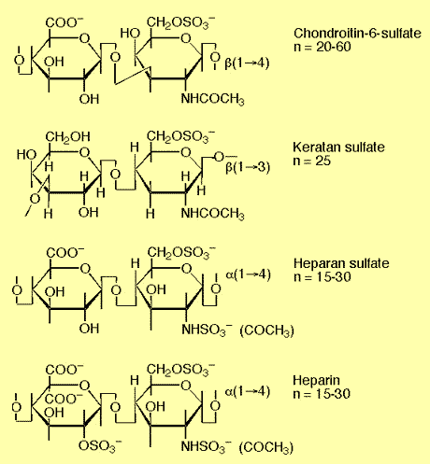
Sulfated Glycosaminoglycans (GAGs)
Prominent in glycocalyx: extracellular matrix of cells
Amount of sulfate depends on availability
Regulate signaling and nutrient uptake
Heparan sulfate

Slide 31
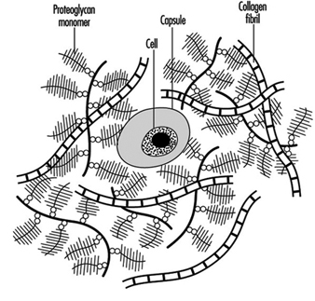
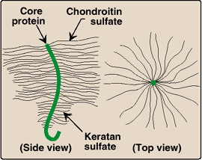
'Bottle brush' molecule structures - protein centered, carbohydrate bristles terminating with sulfate/water 'activity areas'
Notes:
http://www.ilo.org/oshenc/part-i/musculoskeletal-system/item/275-intervertebral-discs?tmpl=component&print=1
And from Glyn

Slide 32
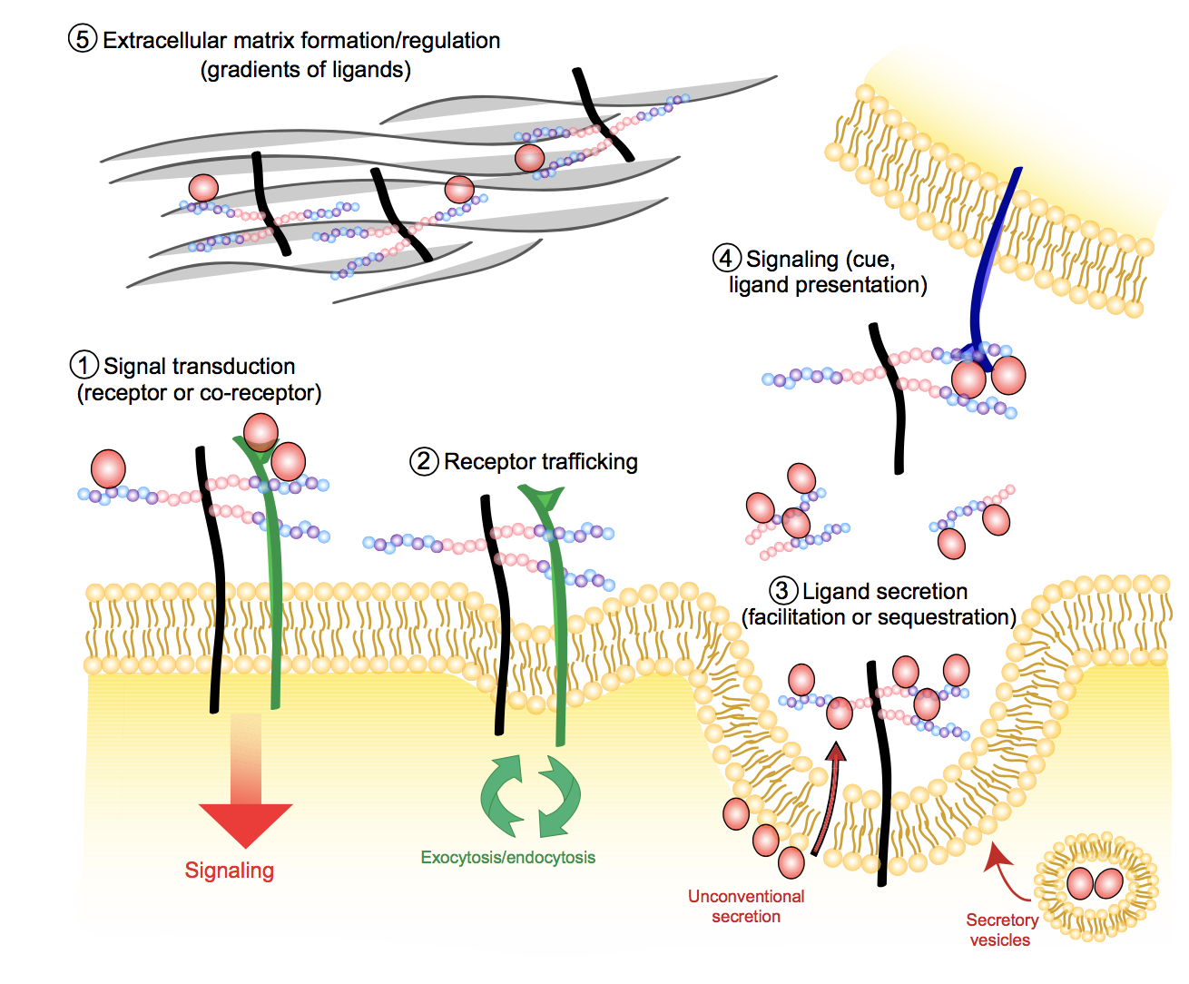
Multiple Roles of Heparan Sulfate Proteoglycans (HSPGs)*
*Figure 3. FE Poulain and HJ Yost. Development 2015; 142: 3456-3467.
Notes:
./heparan_sulfate_proteoglycans_vertebrate_development_2015.pdf .
Fig. 3. The regulation of cell signaling pathways by HSPGs. HSPGs regulate signaling pathways in many different ways, both at the intracellular level and in the extracellular matrix (ECM). HSPGs have been shown to: (1) mediate signal transduction by acting as receptors or co- receptors; (2) regulate receptor trafficking to and from the plasma membrane; (3) control the secretion of ligands; (4) signal to other cells by acting themselves as cues or presenting ligands to their receptors; and (5) regulate the structure of the ECM and the establishment of signaling gradients.

Slide 33
Heparin Protects from ROS due to Iron*
superoxide
Free radical production (Fenton reaction):
Fe(II) + 0₂ + 20H⁻ --> Fe(III)(OH) ₂ + 0₂⁻
But, in the acid environment of heparin:
4Fe(II) + 0₂ + 4H+ --> 4Fe(III) + 2H₂0
water
*M.A. Ross et al., Biochem. J. 1992, 286: 717-720.

Slide 34
Heparin Protects from ROS due to Iron*
superoxide
Free radical production (Fenton reaction):
Fe(II) + 0₂ + 20H⁻ --> Fe(III)(OH) ₂ + 0₂⁻
But, in the acid environment of heparin:
4Fe(II) + 0₂ + 4H+ --> 4Fe(III) + 2H₂0
Iron’s reaction with oxygen is a major contributor to the artery damage caused by inflammation
water
*M.A. Ross et al., Biochem. J. 1992, 286: 717-720.

Slide 35
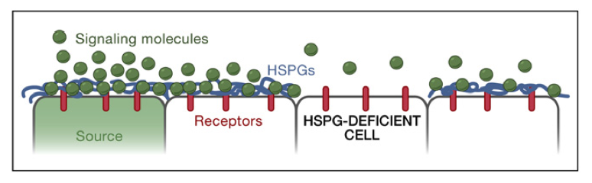
Disrupted Signaling when HSPGs are Depleted*
HSPGs = Heparan Sulfate Proteoglycans
*Figure 5 in P Muller and AF Schier, Developmental Cell 21, July 19, 2011, 145-158.
Notes:
Where???
Figure 5. Effective Diffusion
Interactions of signaling molecules with HSPGs. HSPGs are often associated with epithelial cell surfaces. Binding to HSPGs can alter the mobility of a signal, concentrate ligand at the surface of cells, promote or hinder ligand-receptor interactions, and influence the extracellular stability of a ligand. For example, in the absence of HSPGs, signaling molecules may not be retained on the cell surface and thereby fail to travel to the next cells.
Or Wendy/Ann/
Treasures/2011_extracellular_movement_signaling_molecules.pdf

Slide 36
“The universal non-specific mesenchymal reaction”*
Studied incorporation of sulfur into GAGs in connective tissue surrounding artery walls, in humans and in rats
Showed that aging leads to a reduction in uptake of sulfur AND slower recycling of GAGs
Showed also that atherosclerosis is a special condition where much more sulfur is taken up specifically at the regions where cholesterol and fat have accumulated
*WH Hauss et al., Annals NY Acad Sci 156, 207-218, 1969.
Notes:
Treasures/Hauss_1969_mesenchymal_sulfate_phenomenal_1969.pdf

Slide 37
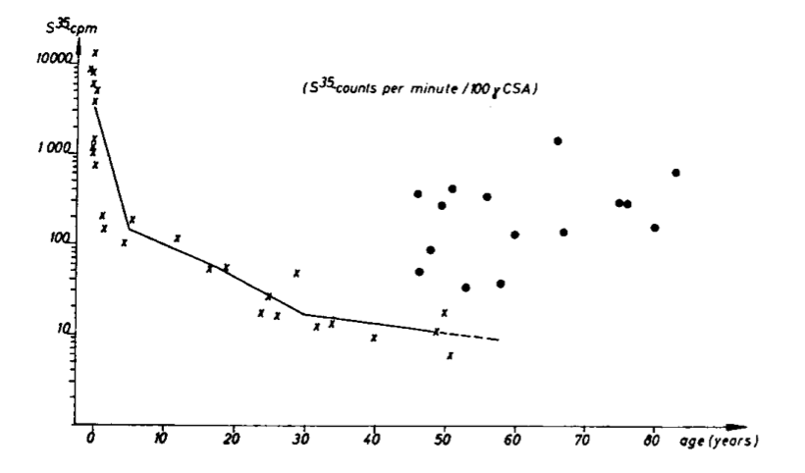
Incorporation of sulfur into GAGs in artery wall*
Huge amounts postnatally
Atherosclerotic arteries
Sulfur Incorporation
Age
*Figure 6, WH Hauss et al., Annals NY Acad Sci 156, 207-218, 1969.
Notes:
Fig. 6. Incorporation of radioactive sulphur into chondroitin sulphuric acids (CSA) of the connec tive tissue of normal ( × ) and atherosclerotic human aortae (Q) in in vitro experiments.
Treasures/Hauss_connective_tissue_chondroitin_sulfate_sulfation_changes_age_1961.pdf
Treasures/Hauss_1969_mesenchymal_sulfate_phenomenal_1969.pdf

Slide 38
Incorporation of sulfur into GAGs in artery wall*
Huge amounts postnatally
Atherosclerotic arteries
Increased turnover of sulfated GAGs
in regions with atherosclerosis
Sulfur Incorporation
Age
*Figure 6, WH Hauss et al., Annals NY Acad Sci 156, 207-218, 1969.
Notes:
Fig. 6. Incorporation of radioactive sulphur into chondroitin sulphuric acids (CSA) of the connec tive tissue of normal ( × ) and atherosclerotic human aortae (Q) in in vitro experiments.
Treasures/Hauss_connective_tissue_chondroitin_sulfate_sulfation_changes_age_1961.pdf
Treasures/Hauss_1969_mesenchymal_sulfate_phenomenal_1969.pdf

Slide 39
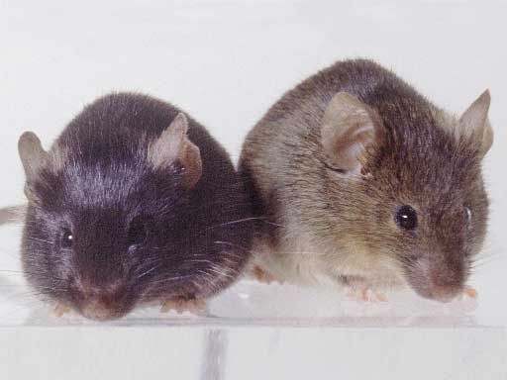
Heparan Sulfate Deficiency and Autism*
Experiment with “designer” mice: impaired heparan sulfate synthesis in brain
Mice exhibited all the classic features of autism – both cognitive and social
* F. Irie et al., Autism-like socio-communicative deficits and stereotypies in mice lacking heparan sulfate. PNAS Mar. 27, 2012, 109(13), 5052-5056.
Notes:
vitaminK/mice_no_heparan_sulfate_get_autism_2012.pdf

Slide 40
Recapitulation
Cholesterol sulfate is supplied to the vasculature by red blood cells and endothelial cells in response to sunlight
  eNOS performs the magic
Sulfate plays an important role in the vasculature to induce flow and protect from damage due to iron
The glycocalyx is a complex structure containing abundant heparan sulfate, which regulates cellular signaling and protects the cell membrane from damage
Heparan sulfate is taken up by cells along with nutrients and it supports acidification of the lysosome to digest nutrients and clear cellular debris
Heparan sulfate deficiency is associated with autism in a mouse model

Slide 41
Bile Acids

Slide 42
Bile Acids: A Brief Tutorial
Bile acids are synthesized in the liver from cholesterol, and circulate between the liver and the digestive tract, with about 5% being lost to the feces with each cycle
  Bile acid synthesis depends on cytochrome P450 enzymes
Bile acids are conjugated with either taurine or glycine and often sulfated before being secreted
Conjugated bile salts sit at the lipid/water interface and, at the right concentration, form micelles and solubilize lipids
Bile acid-containing micelles aid lipases to digest lipids and bring them near the intestinal brush border membrane, promoting fat absorption.

Slide 43
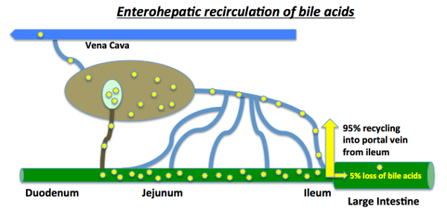
A cartoon depiction of bile circulation
Bile acids are conjugated to either taurine or glycine and then sulfated before being shipped out by the liver
Bacteria strip off taurine/glycine and convert primary to secondary bile acids

Slide 44
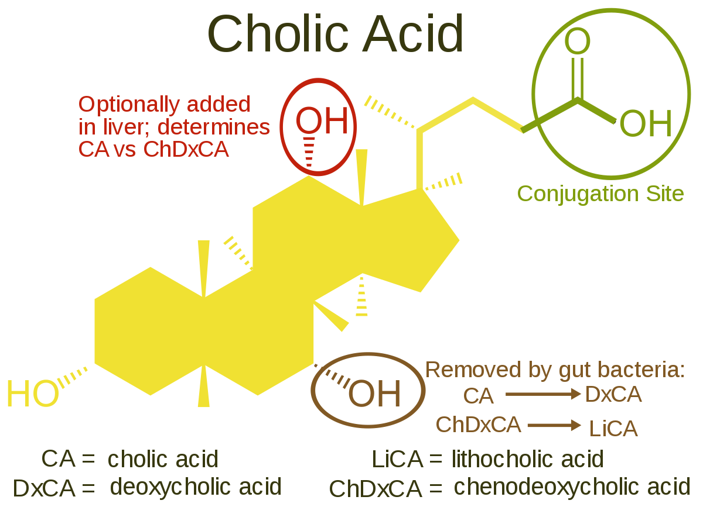
Modifications of Bile Acids
Either glycine
or taurine
Sulfate is often added here
Secondary bile acids
Notes:
WIKI on bile acids.

Slide 45
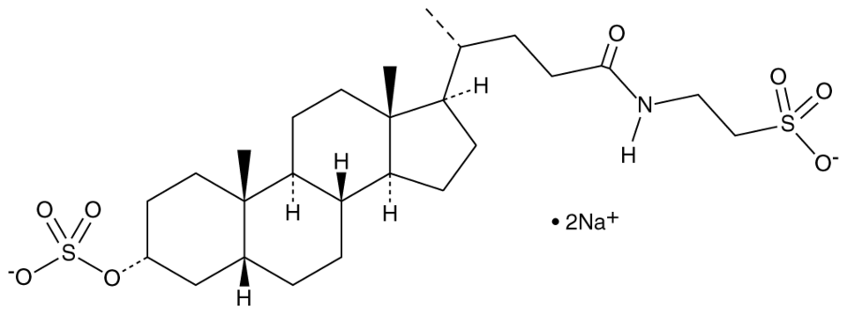
Taurolithocholic acid 3-sulfate
Taurine
Sulfate

Slide 46
A Hypothesis: Liver delivers taurine and glycine to bacteria to synthesize methionine and sulfate for the host
Sulfate
Serine
Sulfite oxidase
Assimilatory sulfite reductase
Taurine
Sulfite
Methionine
Methionine is the universal methyl donor
Glycine
Methylfolate
Glycine cleavage system
Folate

Slide 47
Bifidobacteria modify bile acids to increase gelling potential*
Bifidobacteria are the most significant microbes in the gut for deconjugating taurine and glycine from bile acids
Release of deconjugated bile acids by Bifidobacteria causes the aqueous medium to gel
“If such a phenomenon occurs in physiological conditions of human gut, it may improve bacterial ability to colonize the gastrointestinal tract and their survival in this specific ecological niche.”
*P Jarocki et al. PLOS ONE December 3, 2014; 9(12): e114379.
Notes:
./bifidobacteria_and_bile_salts_2014.pdf

Slide 48
Glyphosate

Slide 49
Main Toxic Effects of Glyphosate*
Kills beneficial gut bacteria and allows pathogens to overgrow
  Bifidobacteria are especially susceptible
Interferes with function of cytochrome P450 (CYP) enzymes
Chelates important minerals (iron, cobalt, zinc, manganese, etc.)
Interferes with synthesis of aromatic amino acids and methionine
  Leads to shortages in critical neurotransmitters and folate
Disrupts sulfate synthesis and sulfate transport
*Samsel and Seneff, Entropy 2013, 15, 1416-1463

Slide 50
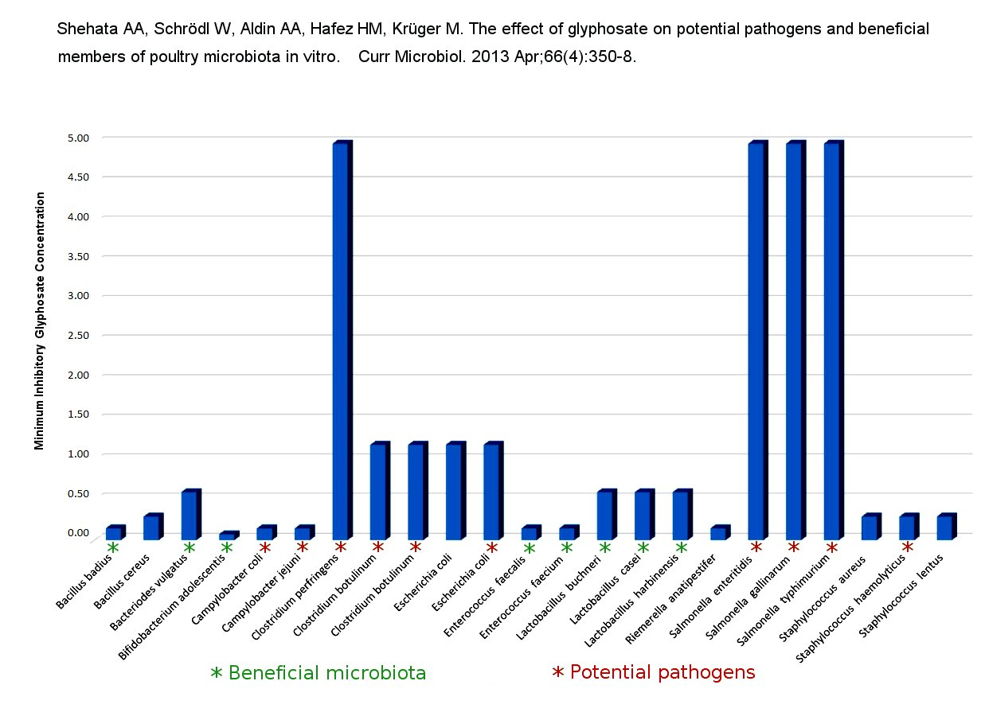
Pathogen Overgrowth in Poultry Microbes Exposed to Glyphosate*
Clostridia
Salmonella
Bifidobacteria
*Plot provided by Dr. Martin Michener
Notes:
From Marty Michener!
Sheehata paper.

Slide 51
Glyphosate contamination in bile acids*
Monsanto’s own early studies found glyphosate contamination in bile acids
Likely mechanism is its role as a glycine analogue:
  Glyphosate conjugates to the bile acids in place of glycine
This would be especially damaging to Bifidobacteria, because they deconjugate the bile acids, thus importing and freeing glyphosate
*Anthony Samsel, personal communication

Slide 52
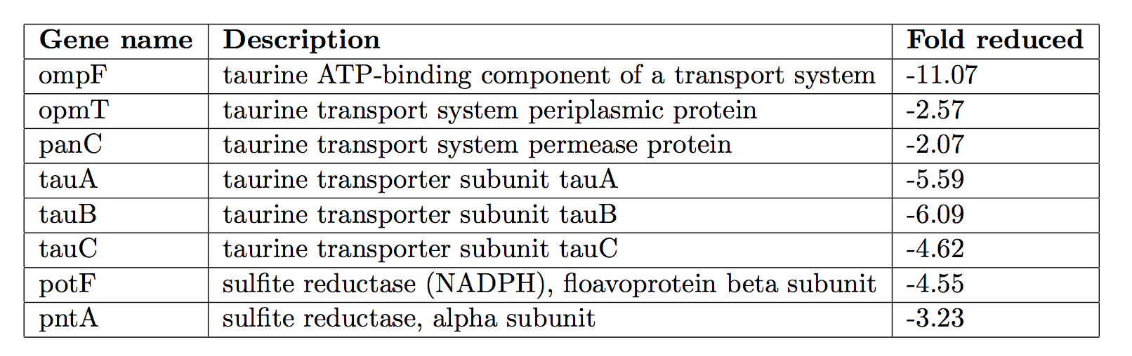
Glyphosate impairs taurine metabolism by E coli*
ompF, involved in taurine transport, was the most reduced enzyme in the entire table
Enzymes involved in both taurine transport/metabolism and assimilatory sulfite incorporation into methionine were suppressed
*Appendix in W Lu et al. Mol BioSyst 2013 9: 522-530.

Slide 53
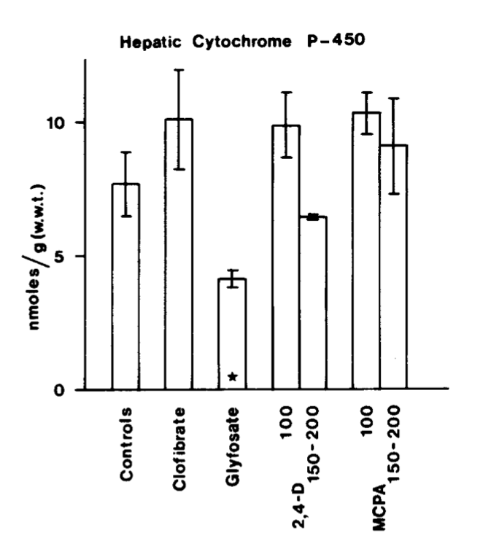
Inhibition of Cytochrome P450 Enzymes (CYPs) by Various Pesticides*
Study in rats on 2,4-D, clofibrate, MCPA, and glyphosate
*E Hetanen et al., Acta Pharmacol. Et Toxicol. 1983, 53, 103-1 12.
Notes:
./glyphosate_inhibits_CYPS_and_other_issues.pdf
Fig. 1. The concentration of hepatic cytochrome P-450 in rats exposed to clofibrate, glyphosate, 2,4dichlorophen- oxyacetic acid (2,4-D) or 4-chloro-2-methylphenoxyace- tic acid (MCPA) for 2 weeks. The doses of 2,4-D and MCPA are also shown. The meansfS.E.M. are shown. The statistical significances were analyzed with Student's t-test using controls as a reference group. The following symbol is used: *: P<0.05.

Slide 54
Bifidobacteria, acetate, NaCl and SO₄⁻² in autism
Autistic children have low Bifidobacteria (p = 0.002)*
Autistic children are hyponatremic (low sodium)**
  Recurring diarrhea (glyphosate induces leaky gut)***
  Depletion of taurine (taurine-conjugated bile acids lost to feces)
Autistic children have low gut acetate (p = 0.00002)*
  Loss of acetate-producing microbes that feed on bile acids
Autistic children have sulfate deficiency****
*JB Adams et al. BMC Gastroenterology 2011; 11:22.
**P Good. Medical Hypotheses 2011;77:1015-1021.
***JJ Gildea et al. Journal of Clinical Nutrition & Dietetics 2017;3:1.1).
****RH Waring and LV Klovrza. J Nutr Environ Med 2000;10:25-32.

Slide 55
A BTBR Mouse Model of Autism*
These mice had all the mouse features of autism
They were fed “standard rodent chow” – glyphosate contaminated?
Some features in the gut:
Reduced levels of bile acids (due to impaired CYP7A1 activity in the liver)
Further reduced levels of secondary bile acids (impaired metabolism by gut microbes)
Reduced levels of Lactobacillus and Bifidobacteria
  These microbes are preferentially killed by glyphosate
Serotonin deficiency
  Serotonin is derived from tryptophan, a product of the shikimate pathway which glyphosate disrupts
*AV Glubeva et al. EBioMedicine. 2017 Oct;24:166-178.
Notes:
Anthony/scleroderma/mouse_model_autism_bile_acids_tryptophan_gut_microbes_2017.pdf

Slide 56
A BTBR Mouse Model of Autism*
These mice had all the mouse features of autism
They were fed “standard rodent chow” – glyphosate contaminated?
Some features in the gut:
Reduced levels of bile acids (due to impaired CYP7A1 activity in the liver)
Further reduced levels of secondary bile acids (impaired metabolism by gut microbes)
Reduced levels of Lactobacillus and Bifidobacteria
  These microbes are preferentially killed by glyphosate
Serotonin deficiency
  Serotonin is derived from tryptophan, a product of the shikimate pathway which glyphosate disrupts
These BTBR mice also had heparan sulfate deficiency in the brain ventricles
and a missing corpus callosum
*AV Glubeva et al. EBioMedicine. 2017 Oct;24:166-178.
Notes:
Anthony/scleroderma/mouse_model_autism_bile_acids_tryptophan_gut_microbes_2017.pdf

Slide 57


Hormones Enhance Sulfate Levels*
Sulfate is the fourth most common anion in the body
Serum sulfate is elevated in infants, young children and pregnant women.
Estrogen, progesterone, growth hormone and insulin-like growth factor all enhance the expression of the sodium-sulfate cotransporter, increasing serum sulfate levels.
*HJ Lee et al. Proc Soc Exp Biol Med. 2000;225(1):49-57.

Slide 58
Hormones Enhance Sulfate Levels*
Aromatase, an enzyme that converts testosterone to estrogen, is a CYP enzyme that is inhibited by glyphosate.
This could partially explain the increased risk to autism in boys.
Sulfate is the fourth most common anion in the body
Serum sulfate is elevated in infants, young children and pregnant women.
Estrogen, progesterone, growth hormone and insulin-like growth factor all enhance the expression of the sodium-sulfate cotransporter, increasing serum sulfate levels.
*HJ Lee et al. Proc Soc Exp Biol Med. 2000;225(1):49-57.

Slide 59
Sulfate Deficient Mice*
Mice missing the sodium sulfate cotransporter gene (NaSi-/- mice) survived in utero but exhibited several metabolic problems:
Severely reduced serum sulfate levels (75% reduction)
Significantly reduced litter size and miscarriages
A seizure disorder
Stunted growth
Increased liver size
1.5 to 2-fold increased phenol sulfotransferase activity
*PA Dawson et al. PNAS 2003; 100(23): 13704-13709.
Notes:
./Dawson_2003_low_sulfate_seizures_infertility_sodium_sulfate_cotransporter_defective.pdf
Sodium_sulfate_cotransport.text
Sulfotransferase (ST) Assays.

Slide 60
Sulfate Deficient Mice*
Mice missing the sodium sulfate cotransporter gene (NaSi-/- mice) survived in utero but exhibited several metabolic problems:
Severely reduced serum sulfate levels (75% reduction)
Significantly reduced litter size and miscarriages
A seizure disorder
Stunted growth
Increased liver size
1.5 to 2-fold increased phenol sulfotransferase activity
Toxic phenol-sulfate metabolites
are implicated in autism**
*PA Dawson et al. PNAS 2003; 100(23): 13704-13709.
Notes:
./Dawson_2003_low_sulfate_seizures_infertility_sodium_sulfate_cotransporter_defective.pdf
Sodium_sulfate_cotransport.text
Sulfotransferase (ST) Assays.

Slide 61
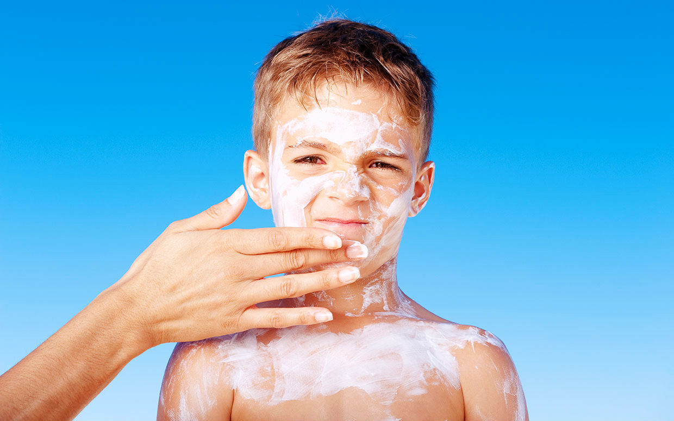

eNOS is Very Vulnerable*
*S. Seneff et al., Entropy 2012, 14, 2492-2530

Slide 62
eNOS is Very Vulnerable*
eNOS depends on:
  Cobalamin (vitamin B12, cobalt)
  Heme iron, sulfur, zinc, oxygen
  Glutathione
  Sunlight/melanin
  Tryptophan: source of NAD
eNOS is a cytochrome P450 enzyme:
  Highly vulnerable to various environmental toxicants like mercury, aluminum, glyphosate, etc.
*S. Seneff et al., Entropy 2012, 14, 2492-2530.

Slide 63
eNOS is Very Vulnerable*
eNOS depends on:
  Cobalamin (vitamin B12, cobalt)
  Heme iron, sulfur, zinc, oxygen
  Glutathione
  Sunlight/melanin
  Tryptophan: source of NAD
eNOS is a cytochrome P450 enzyme:
  Highly vulnerable to various environmental toxicants like mercury, aluminum, glyphosate, etc.
Glyphosate disrupts eNOS function in multiple ways
*S. Seneff et al., Entropy 2012, 14, 2492-2530.

Slide 64
Glyphosate disrupts eNOS!
Glyphosate chelates cobalt, zinc and iron, making them unavailable
Glyphosate interferes with the synthesis of pyrrole, the precursor to heme (in eNOS)
Glyphosate depletes glutathione by interfering with methionine synthesis by gut microbes
Glyphosate depletes melanin in the skin (product of shikimate pathway)
  Impaired conversion of UV light to visible light
Glyphosate disrupts tryptophan synthesis, depleting NAD
eNOS has two highly conserved glycine residues
  Essential for attaching to the membrane and forming a dimer

Slide 65
High Serum Lipids is Correlated with Glyphosate Usage on Corn and Soy Crops
Collaboration with Dr. Chen Li and Dr. Nancy Swanson

Slide 66
High Serum Lipids is Correlated with Glyphosate Usage on Corn and Soy Crops
Glyphosate disrupts bile acid synthesis and forces liver to distribute cholesterol as LDL particles instead
Collaboration with Dr. Chen Li and Dr. Nancy Swanson

Slide 67
Diseases Linked to
Sulfate Deficiency

Slide 68
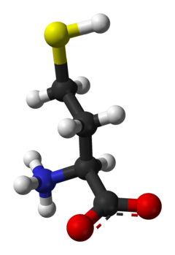
Elevated Homocysteine and Heart Disease*
Sulfur
587 patients with coronary artery disease followed over median period of 4.6 years
Homocysteine > 15 μmol/Liter → 6.5-fold increase in death rate compared to
homocysteine < 10 μmol/Liter
*P.O. Lim et al., Journal of Human Hypertension (2002) 16, 411–415.
Notes:
In celiac/celiac_disease_hypertension.pdf

Slide 69
Hypothesis:
Homocysteine becomes elevated when sulfate supplies are depleted because it can be a source of new sulfate

Slide 70
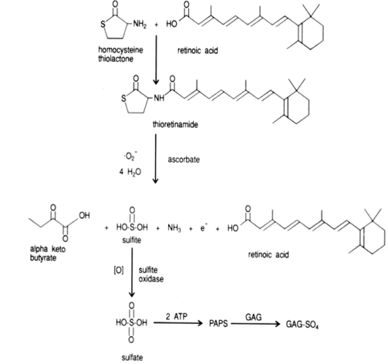
Pathway from Homocysteine to Sulfate*
When folate and B12 are deficient, nearly all homocysteine is converted to homocysteine thiolactone
homocysteine thiolactone
Vitamin A
thioretinamide
Superoxide:
Reactive oxygen species
(ROS)
Vitamin C
sulfite
alpha keto butyrate
retinoic acid
Sulfite oxidase
PAPS
*McCully, Annals of Clinical and Laboratory Science 41:4, 300-313, 2011
sulfate
Notes:
Spacedoc/McCully/ChemicalPathologyHomocysteineV_McCully.pdf
Figure 1. Hypothetical scheme for synthesis of thioretinamide, oxidation to sulfite and sulfate, and activation of sulfate to phosphoadenosine phosphosulfate, explains sulfation of glycosaminoglycans (GAG) to form sulfate esters [2]. In this scheme superoxide is synthesized from the heme oxygenase group of cystathionine synthase [34], catalyzing retinoic acid synthesis from retinol. Synthesis of thioretinamide from retinoic acid and homocysteine thiolactone is catalyzed by cystathionine synthase and dehydroascorbate.
is hydro- lyzed to Hcy by a calcium-dependent Hcy thiolactonase (HTase) tightly associated with HDL in serum (Jakubowski 1999a). !!
When methionine synthase activity is inhibited by folate or vitamin B-12 deprivation, almost all Hcy is converted to thiolactone.
!

Slide 71
Pathway from Homocysteine to Sulfate*
GAGs = glycosaminoglycans!
GAG-sulfate
*McCully, Annals of Clinical and Laboratory Science 41:4, 300-313, 2011
Notes:
Spacedoc/McCully/ChemicalPathologyHomocysteineV_McCully.pdf
Figure 1. Hypothetical scheme for synthesis of thioretinamide, oxidation to sulfite and sulfate, and activation of sulfate to phosphoadenosine phosphosulfate, explains sulfation of glycosaminoglycans (GAG) to form sulfate esters [2]. In this scheme superoxide is synthesized from the heme oxygenase group of cystathionine synthase [34], catalyzing retinoic acid synthesis from retinol. Synthesis of thioretinamide from retinoic acid and homocysteine thiolactone is catalyzed by cystathionine synthase and dehydroascorbate.
is hydro- lyzed to Hcy by a calcium-dependent Hcy thiolactonase (HTase) tightly associated with HDL in serum (Jakubowski 1999a). !!
When methionine synthase activity is inhibited by folate or vitamin B-12 deprivation, almost all Hcy is converted to thiolactone.
!

Slide 72
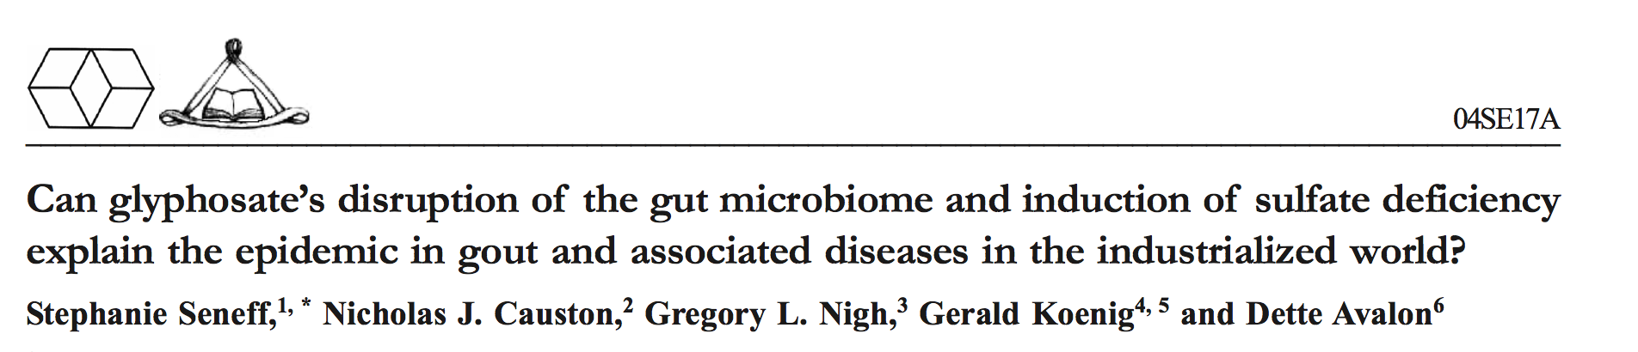
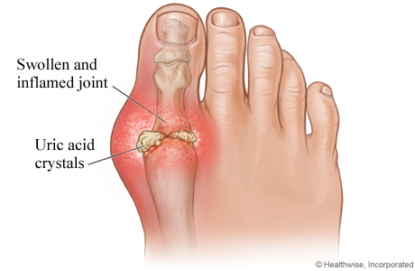
*
Paper explains how the complex signaling cascade that takes place in the gouty toe joint is a carefully orchestrated plan to synthesize cholesterol sulfate and supply it to invading immune cells.
*Seneff et al., Journal of Biological Physics and Chemistry 17;2017:53-76

Slide 73
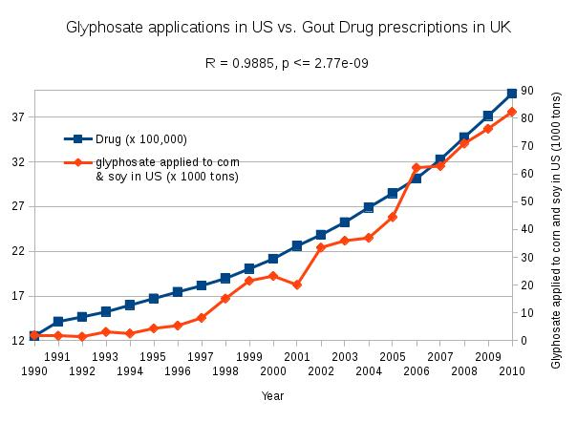
*Seneff et al., Journal of Biological Physics and Chemistry 17;2017:53-76

Slide 74
Heparan Sulfate Deficiency in Autism
Humans:
“Heparan sulfate deficiency in autistic postmortem brain tissue from the subventricular zone of the lateral ventricles”*
Mice:
“Hippocampus/amygdala alterations, loss of heparan sulfates, fractones and ventricle wall reduction in adult BTBR T+ tf/J mice, animal model for autism”**
*BL Pearson et al. Behav Brain Res. 2013; 243: 138–145
**F Mercier et al. Neurosci Lett 2012;506(2):208-13.
Notes:
eparan_sulfate_deficiency_autism_brains_postmortem.pdf

Slide 75
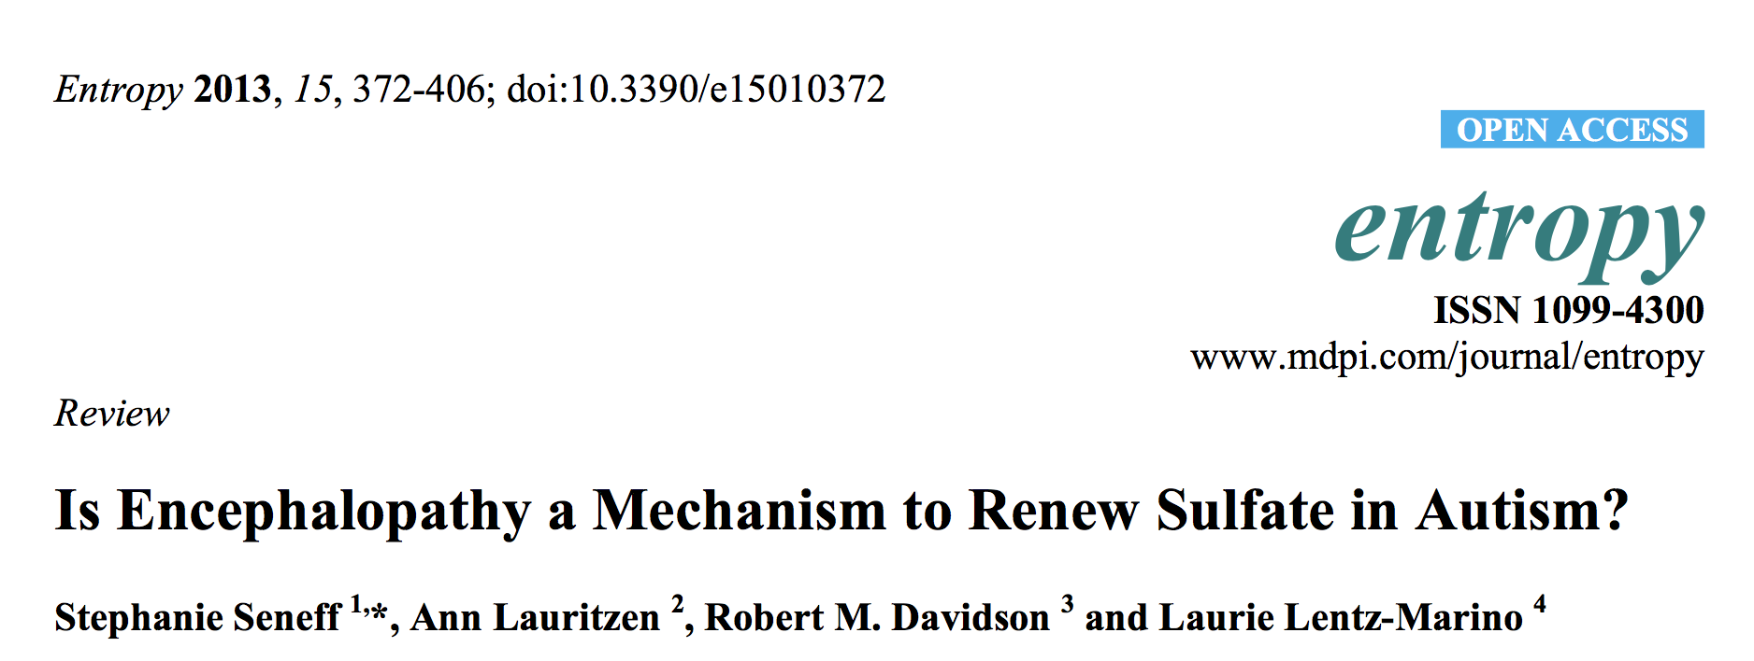
Chronic low-grade encephalopathy (brain inflammation) characterizes autism. Signaling cascade in the brain leads to taurine release and hypothesized synthesis of sulfate from taurine by microbes

Slide 76
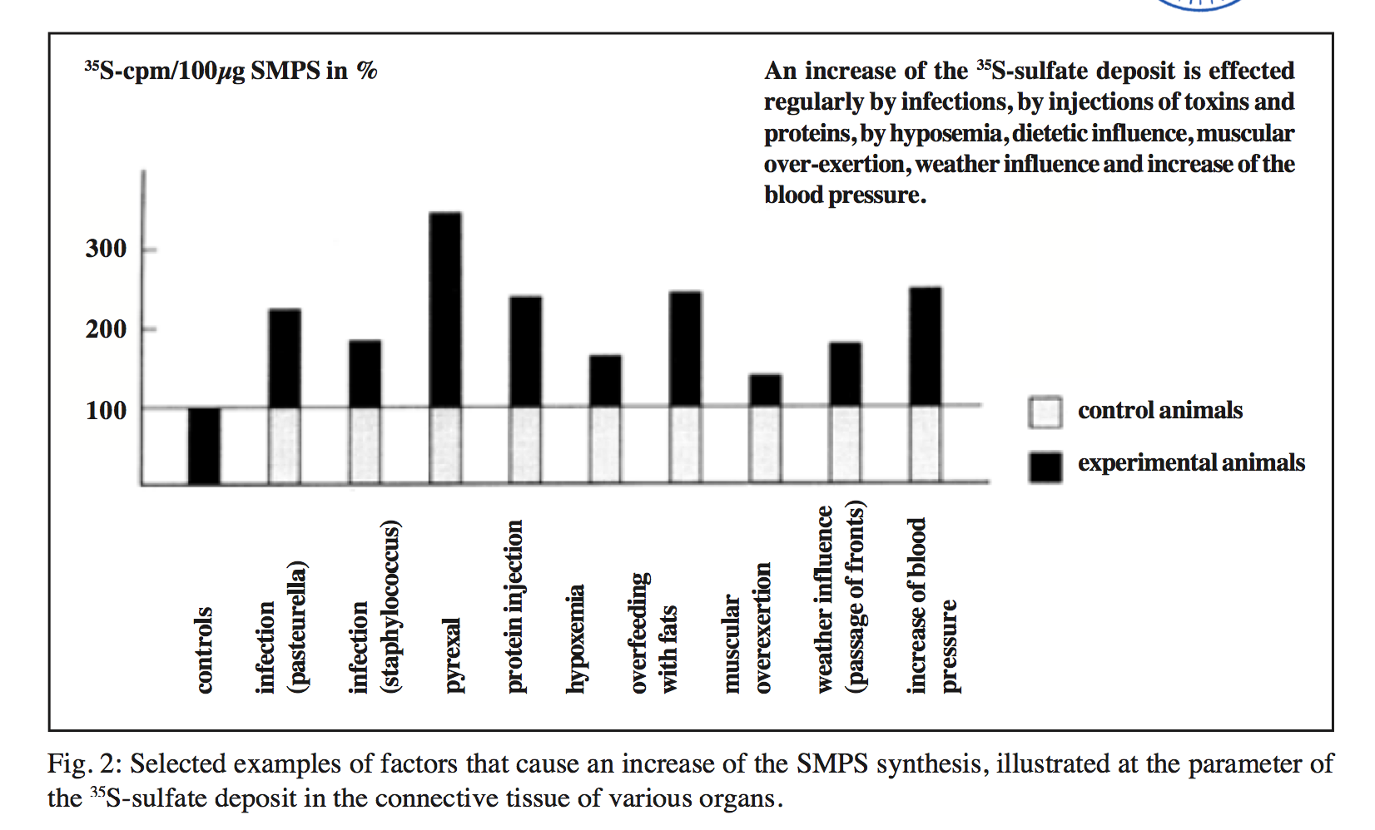
Various Factors that Increase Sulfate*
An increase of the 35S-sulfate deposit is effected regularly by infections, by injections of toxins and proteins, by hypoxemia, dietetic influence, muscular over-exertion, weather influence and increase of the blood pressure.
SMPS= Sulfated mucopolysaccharides (GAGs)
*Report by Bernhard Muschlien
SMPS = Sulfated mucopolysaccharides = glycosaminoglycans
* First published in the German language in the SANUM-Post magazine (17/ 1991)
Notes:
Treasures/bacteria_renew_sulfate_German.pdf

Slide 77
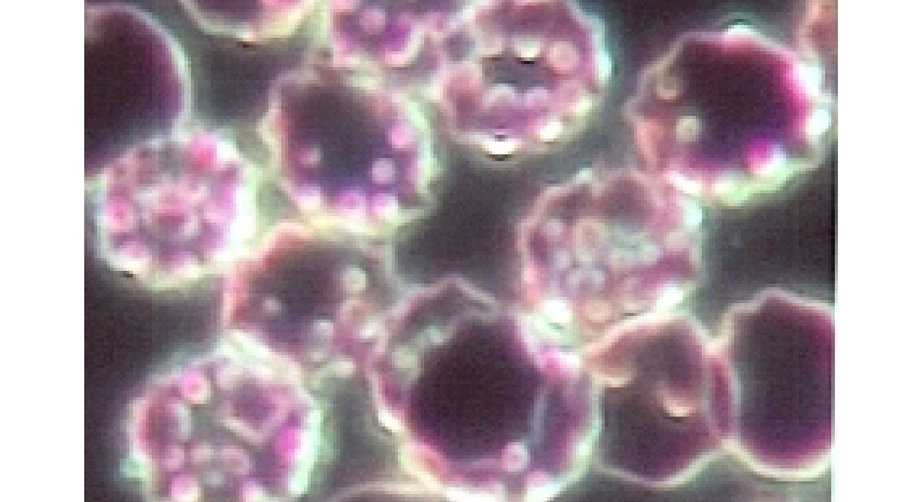
Chlamydia pneumoniae
Cause pneumonia when they infect the lungs
Show up frequently in cardiovascular plaque
Show up frequently in Alzheimer’s plaque
What are they doing there???

Slide 78
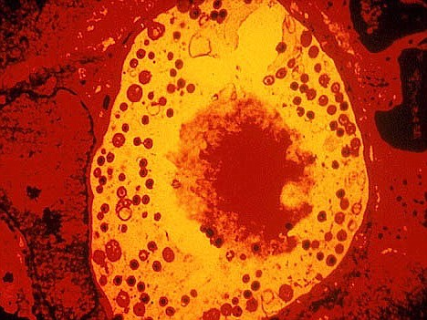
Chlamydia Produce Heparan Sulfate!*
Chlamydia are viable only inside host cells
They set up housekeeping in vacuoles within the cell (e.g., a macrophage in the plaque)
They produce a glucosamine-containing sulphated polysaccharide that is nearly indistinguishable from heparan sulfate
They have a unique set of enzymes for this
* S.J. Rasmussen-Lathrop et al, Cell Microbiol. 2000 Apr, 2(2), 137-44.
Notes:
vitaminK/chlamydia_produce_heparan_sulfate.text

Slide 79
Chlamydia Produce Heparan Sulfate!*
Chlamydia are viable only inside host cells
They set up housekeeping in vacuoles within the cell (e.g., a macrophage in the plaque)
They produce a glucosamine-containing sulphated polysaccharide that is nearly indistinguishable from heparan sulfate
They have a unique set of enzymes for this
Are they assisting the host by boosting heparan sulfate levels in the artery wall?
* S.J. Rasmussen-Lathrop et al, Cell Microbiol. 2000 Apr, 2(2), 137-44.
Notes:
vitaminK/chlamydia_produce_heparan_sulfate.text

Slide 80
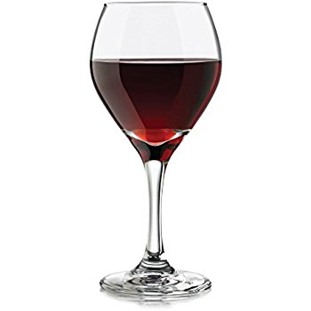
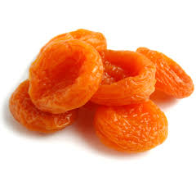
Sulfite Metabolism: Sulfur Sensitivity
Depends on molybdenum and heme and a highly conserved glycine residue
Very Toxic!
Sulfate
X
Sulfite oxidase
Inhibited in E coli
by glyphosate
Desulfovibrio
overgrowth
Sulfite
Sulfite
Assimilatory
Sulfite reductase
X
Dissimilatory
Sulfite reductase
Methionine
Hydrogen
Sulfide
Hydrogen
Sulfide
Notes:
dissimilatory_sulfite_reductase_no_glycine_2010
G473D_mutation_sulfite_oxidase_destroys_it_2006.pdf

Slide 81
Sulfite Metabolism: Sulfur Sensitivity
Depends on molybdenum and heme and a highly conserved glycine residue
Very Toxic!
Desulfovibrio overgrowth is linked to autism.
Desulfovibrio convert mercury to a very toxic organic methylmercury metabolite.
Sulfate
X
Sulfite oxidase
Inhibited in E coli
by glyphosate
Desulfovibrio
overgrowth
Sulfite
Sulfite
Assimilatory
Sulfite reductase
X
Dissimilatory
Sulfite reductase
Methionine
Hydrogen
Sulfide
Hydrogen
Sulfide
Notes:
dissimilatory_sulfite_reductase_no_glycine_2010
G473D_mutation_sulfite_oxidase_destroys_it_2006.pdf

Slide 82
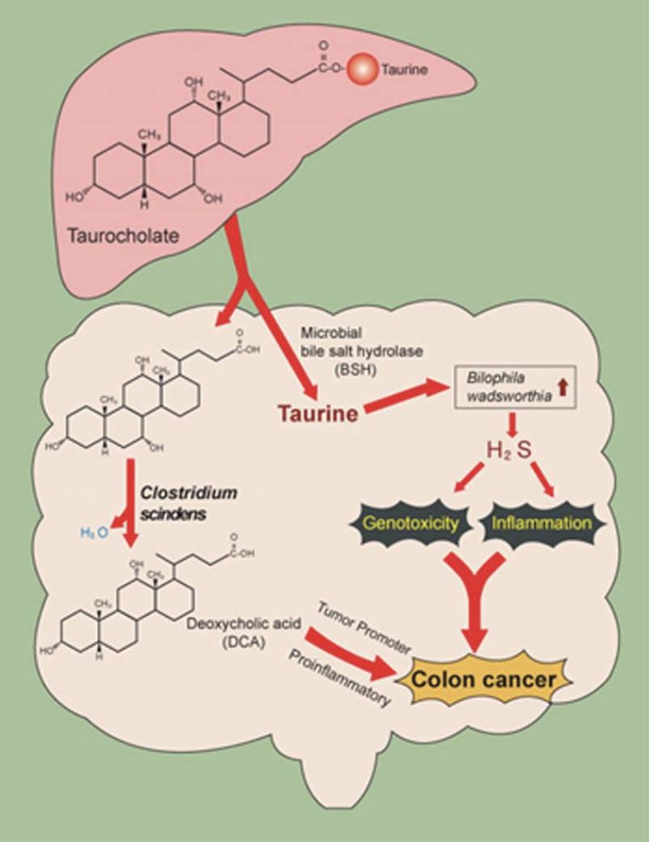
Colon Cancer*
Clostridia (overgrowth with glyphosate exposure) leads to inflammation in the gut
Assimilatory sulfite reduction is disturbed by glyphosate, allowing overgrowth of sulfur-reducing bacteria and excessive production of hydrogen sulfide
This increases risk to colitis and, over time, leads to colon cancer, an epidemic in America
*JM Ridlon et al.Gut Microbes 2016; 7(3): 201-215.
Notes:
./taurocholic_acid_metabolism_by_gut_microbes_colon_cancer.pdf
Figure 3. Metabolism of bile salt, taurocholic acid, by the gut microbiome. Gut microbes in the ileum and colon deconjugate bile salts to free bile acids by bile salt hydrolase. Taurine, because of sulfite moiety, can provide pathobionts in the gut with a termi- nal electron acceptor, allowing for their growth and expansion in the gut. High-fat diet is associated with increased taurine-conju- gation in humans. Free primary bile acids are further metabolized to toxic secondary ones that can accumulate in the bile pool in humans and alter host physiology.

Slide 83
Curcumin and
Other Flavonoids

Slide 84
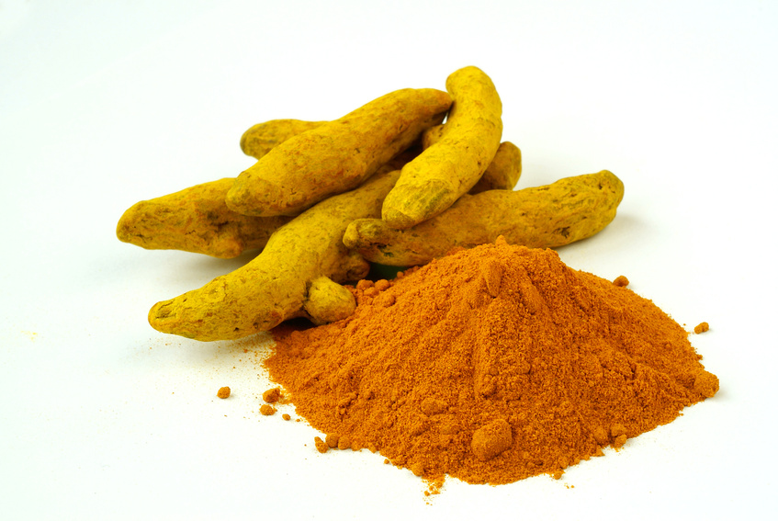
Curcumin Has Many Benefits*
Suppresses carcinogenesis in skin, stomach, colon, breast and liver
Induces apoptosis in a wide variety of tumor cells
Downregulates various proinflammatory cytokines
There is a low incidence of colorectal cancer in India where curcumin is heavily used in curries
* SK Varid et al, Cancer Epidemiol Biomarkers Prev 2008;17:1411-1417.
Notes:
Cancer/curcumin_bioavailability_sulfate.pdf

Slide 85
Curcumin Has Many Benefits*
An intractable myeloma was sent into remission with curcumin therapy (8g/day) and hyperbaric oxygen
*Zaidi A, et al. BMJ Case Rep April 16 2017. doi:10.1136/bcr-2016-218148
* SK Varid et al, Cancer Epidemiol Biomarkers Prev 2008;17:1411-1417.
Notes:
curcumin_cancer_remission_2017.pdf ~
Cancer/curcumin_bioavailability_sulfate.pdf

Slide 86
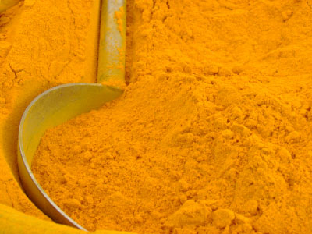
Curcumin Has Many Benefits*
Loss of body fat and adipose- associated macrophages
Reduced inflammatory- related atherogenesis
Antidiabetic effect
  Lower Hemoglobin A1c
Lower total cholesterol and LDL-C
Higher HDL-C.
*S Cuengsamarna et al., journal of Nutritional Biochemistry 25 (2014) 144–150.
Notes:
GerryKoenig/Reduction_of_atherogenic_risk_in_patients_with_type_2_diabetes_bycurcuminoid_extract_-_an_RCT_marked.pdf

Slide 87
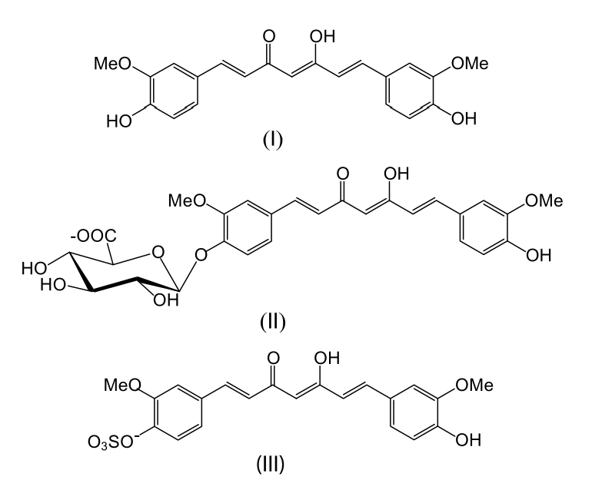
Three Forms of Curcumin*
SULFATE!!
* Figure 1 in SK Varid et al, Cancer Epidemiol Biomarkers Prev 2008;17:1411-1417.
Notes:
Figure 1. Structures of curcumin (I), curcumin glucuronide (II ), and curcumin sulfate (III ).
Cancer/curcumin_bioavailability_sulfate.pdf

Slide 88
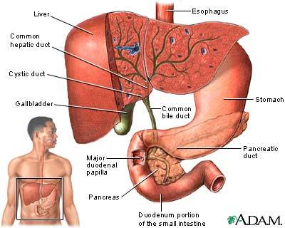
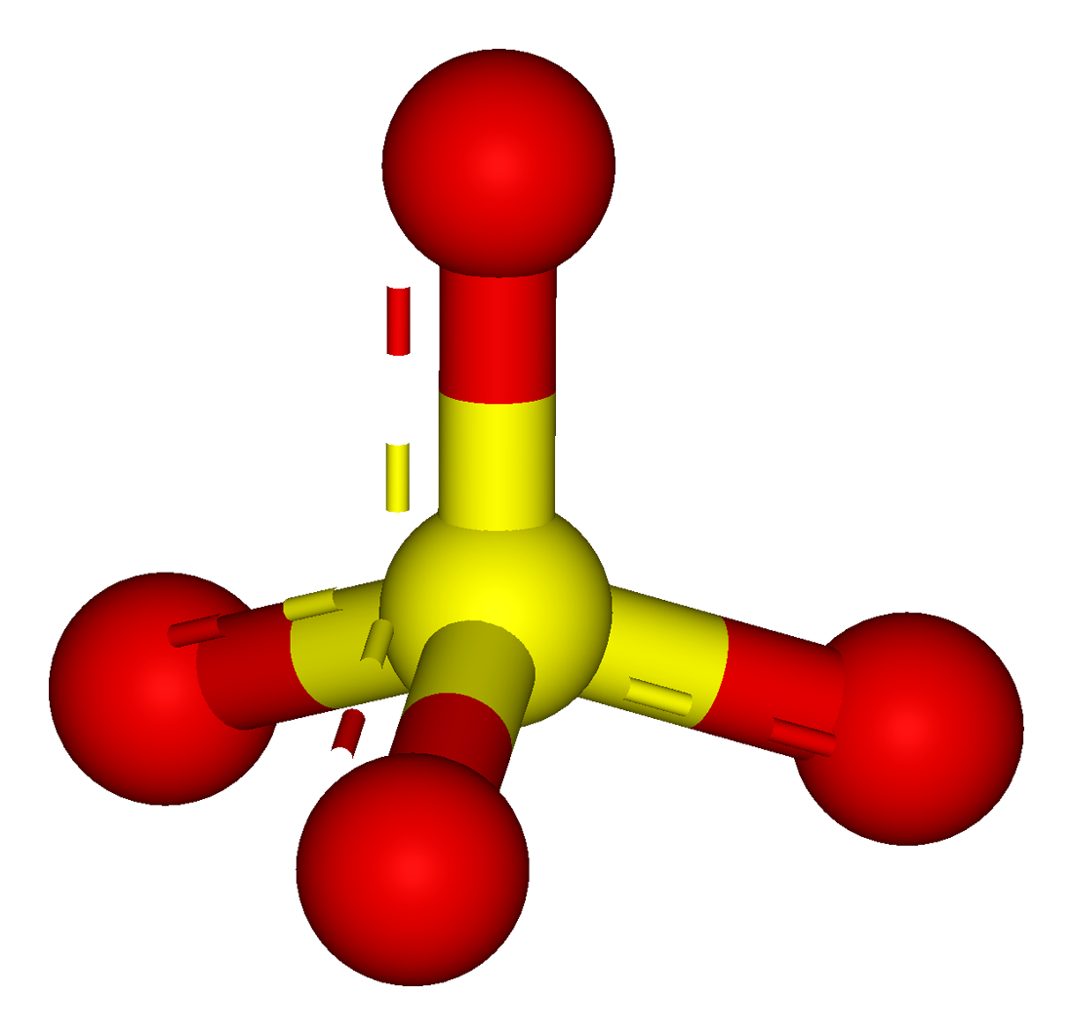
Curcumin Goes Around and Around Delivering Sulfate to Liver!
curcumin

Slide 89
Curcumin Prevents Diabetes*
CONCLUSIONS:
“A 9-month curcumin intervention in a prediabetic population significantly lowered the number of prediabetic individuals who eventually developed type 2 diabetes. In addition, the curcumin treatment appeared to improve overall function of [pancreatic] beta-cells, with very minor adverse effects.”
*S Chuengsamarn et al., Diabetes Car 35, 2012, 2121-2127
Notes:
./Curcumin_Extract_for_Prevention_of_T2D.pdf

Slide 90
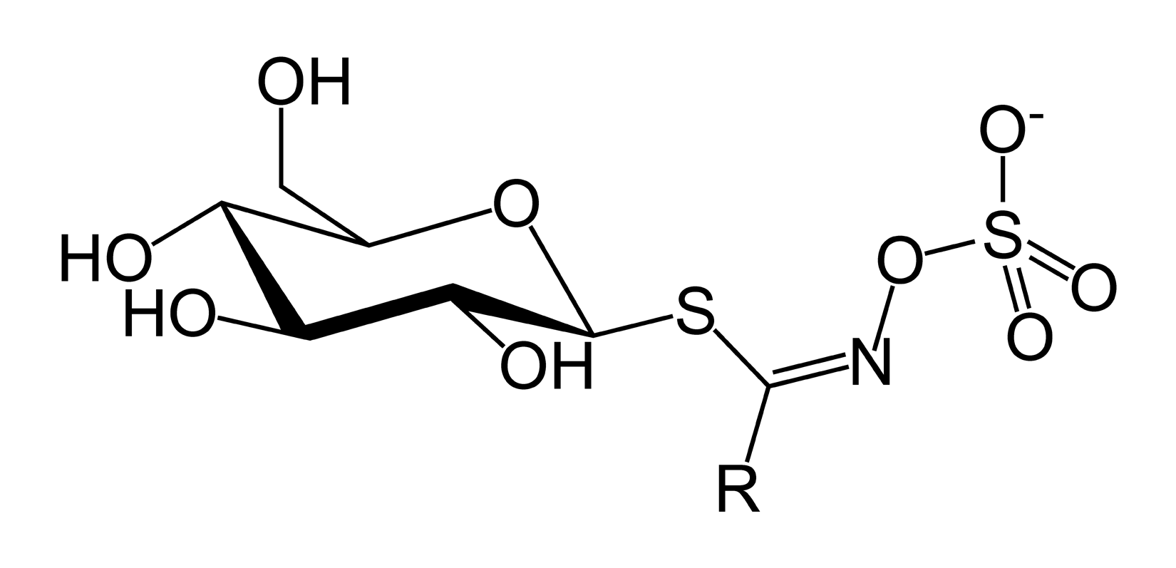
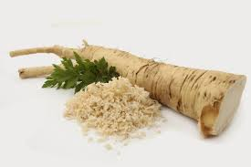
Glucosinolates!
Natural components of many pungent plants such as mustard, cabbage and horseradish
Contribute to plant defense against pests and diseases
Notes:
Horseradish!

Slide 91


Broccoli Sprouts*
Sprouts contain 30x nutrients of organic vegetables
Grow your own and eat them raw!
Controlled study in China:
Benzene and acrolein detoxed into urine
These are chemicals in dirty air from car exhaust and burning fuels
glucoraphanin
*articles.mercola.com/sites/articles/archive/2014/06/30/broccoli-sprout-detox.aspx
Notes:
http://articles.mercola.com/sites/articles/archive/2014/06/30/broccoli-sprout-detox.aspx
BroccoliSprouts.pdf
glucoraphanin

Slide 92



Quercetin: A Sulfate Transporter*
Sulfate
Glucuronate
Net effect:
gut delivers sulfate to the liver
*IR Rowland, Toxicol Pathol 1988 16:147-153.

Slide 93

Choline sulfate!!*
Produced by plants, lichens, algae, fungi, and several bacterial species
Experiment demonstrated that it had superior capabilities to inhibit amyloid formation in pancreatic beta cells
  Amyloid in beta cells is akin to amyloid beta in Alzheimer‘s disease and plays a major role in type-II diabetes
*M. Hagihara et al., FEBS Open Bio 2 (2012) 20–25.
Notes:
Alzheimers/choline_sulfate_inhibits_amyloid_formation.pdf*M. Hagihara et al., FEBS Open Bio 2 (2012) 20–25.

Slide 94
Prevention of Disease
through Diet and Lifestyle

Slide 95



Most Important: Go Organic!

Slide 96
How Much Does it Cost?
Food Organic Conventional
celery 2.99 1.99
cauliflower 4.99 2.99
Bartlett pears 2.69 1.99
orange juice 3.99 2.99
eggs 5.69 3.99
milk 4.69 2.99
cereal 4.56 3.91
TOTAL 29.60 20.85
increase bill by ~40%

Slide 97



Probiotics! – Maintain Healthy Gut

Slide 98



Sauerkraut and apple cider vinegar contain acetobacter, one of the very few microbes that can metabolize glyphosate
Yogurt and kimchi probably do too

Slide 99
Are We Getting Enough Sulfur in Our Diet?*
Most abundant mineral element behind calcium and phosphorus
Chondroitin sulfate, glucosamine sulfate, etc. used to treat diseases of the joints
“Out of this study came information that suggested that a significant proportion of the population that included disproportionally the aged, may not be receiving sufficient sulfur and that these dietary supplements, were very likely exhibiting their pharmacological actions by supplying inorganic sulfur.”
*ME Nimni et al., Nutrition & Metabolism 2007, 4:24
Notes:
./enough_sulfur_question_mark_2007.pdf

Slide 100












Eat Foods Containing Sulfur
Notes:
http://healthyeatingclub.com/info/books-phds/books/foodfacts/html/data/data5g.html

Slide 101
Some sulfur-containing supplements
Biotin
Taurine
N-acetyl Cysteine
Glutathione
S-adenosyl Methionine
Alpha Lipoic Acid
DMSO (dimethyl sulfoxide)
MSM (methyl sulfonyl methane)
DMPS (chelating agent)
Epsom Salts

Slide 102






Flavonoids and Polyphenols!

Slide 103



Escape to a sunny place in winter!
Notes:
Summer vacation on Mediterranean Sea resort, Antalya, Turkey

Slide 104

If you Live in Canada, Use a Sunlamp!

Slide 105



Epsom Salts!
Magnesium Sulfate in hot bath water is a cheap and easy way to get sulfate supply to the skin
Infrared heat also beneficial!

Slide 106




Treating Glyphosate Poisoning in Animals (e.g., cows) *
Activated charcoal, bentonite clay, humic and fulvic acids, and sauerkraut juice have been shown to be effective in reducing urinary levels of glyphosate and improving animal health
Sauerkraut
Juice
Fulvic Acid
Activated Charcoal
Bentonite Clay
*H Gerlach et al., J Environ Anal Toxicol 2014, 5:2
Notes:
Glyphosate/Monika_cows_humic_acid_fulvic_acid_treat_glyphosate.pdf
Activated charcoal
活性炭
clay
粘土
Niántǔ
Huóxìngtàn

Slide 107
Summary
Cholesterol sulfate is an essential molecule in the body to maintain vascular health
  Produced in the skin upon sunlight exposure
Heparan sulfate plays multiple roles in the body and its deficiency is linked to autism
Bile acids play an essential role in supplying taurine to the body, and taurine is an essential storage form of sulfate
  Taurine deficiency may be a key factor in autism
Glyphosate is a pervasive toxicant that is causing a major health crisis in the US
  Much of its toxicity relates to disruption of gut microbes
An organic whole foods diet rich in sulfur, cholesterol and polyphenols has many health benefits
It is essential to get abundant sunlight exposure to the skin without sunscreen

Slide 108
Thank you for listening!

